Slide 1

UTA Logo on blue background
Updated 05/17/22

Slide 2
DIAZ SIFONTES FAMILY
Presented by:
Radha Yashwanth Uppuganti – 1001964009
Bhargava Manikanta Aditya Tummalapenta – 1001965491
Sravani Ravipati - 1001979731

Slide 3
INTRODUCTION
The Diaz Sifontes Family is a well-known and wealthy family that lives in an island , Margarita, in the southern part of the Americas.
Having 275 families, maintenance of records is such a huge task to do. Hence, we were asked to create a website to help them for that task.

Slide 4
AIM/PURPOSE
The main aim of the website is to manage data of the sifontes family thoroughly.
Data such as land owned, projects or business owned by the family members and any completed or on-going trials are recorded in the database.
This is done to make their life easy when a family member or ancestor wanted to see how well their children/family is doing

Slide 5
COMPONENTS
WEBSITE
DATABASE

Slide 6
DATABASE
All the data used in this website is stored in ‘bat5491_DiazSifontesFamily’ database.
This database is present on phpMyAdmin on the UTA CLOUD.
It contains the following tables:
AncestorDetails: Contains the details of all the 14 ancestors of the Diaz Sifontes Family, including their total land owned and worth.
Trials: This table contains the details of all the trials that are underway and/or have been completed in the past.

Slide 7
AncestorProperties: This table contains the land owned by the 14 ancestors and their values.
Business: This tables contains all the projects that are run on the inherited land of the family members
ContactUs: This table is used as a database for entries from the contact us page.
FamilyGroup: This table contains the Family group and their members
UserDetails: This table consists data related to the family members.
UserProperties: This table contains data of the properties/land owned by the family members.

Slide 8
WEBSITE
The website contains 8 base pages
Home
About
Blog
SignUp
SignIn
memberHome
adminHome
ForgotPassword

Slide 9
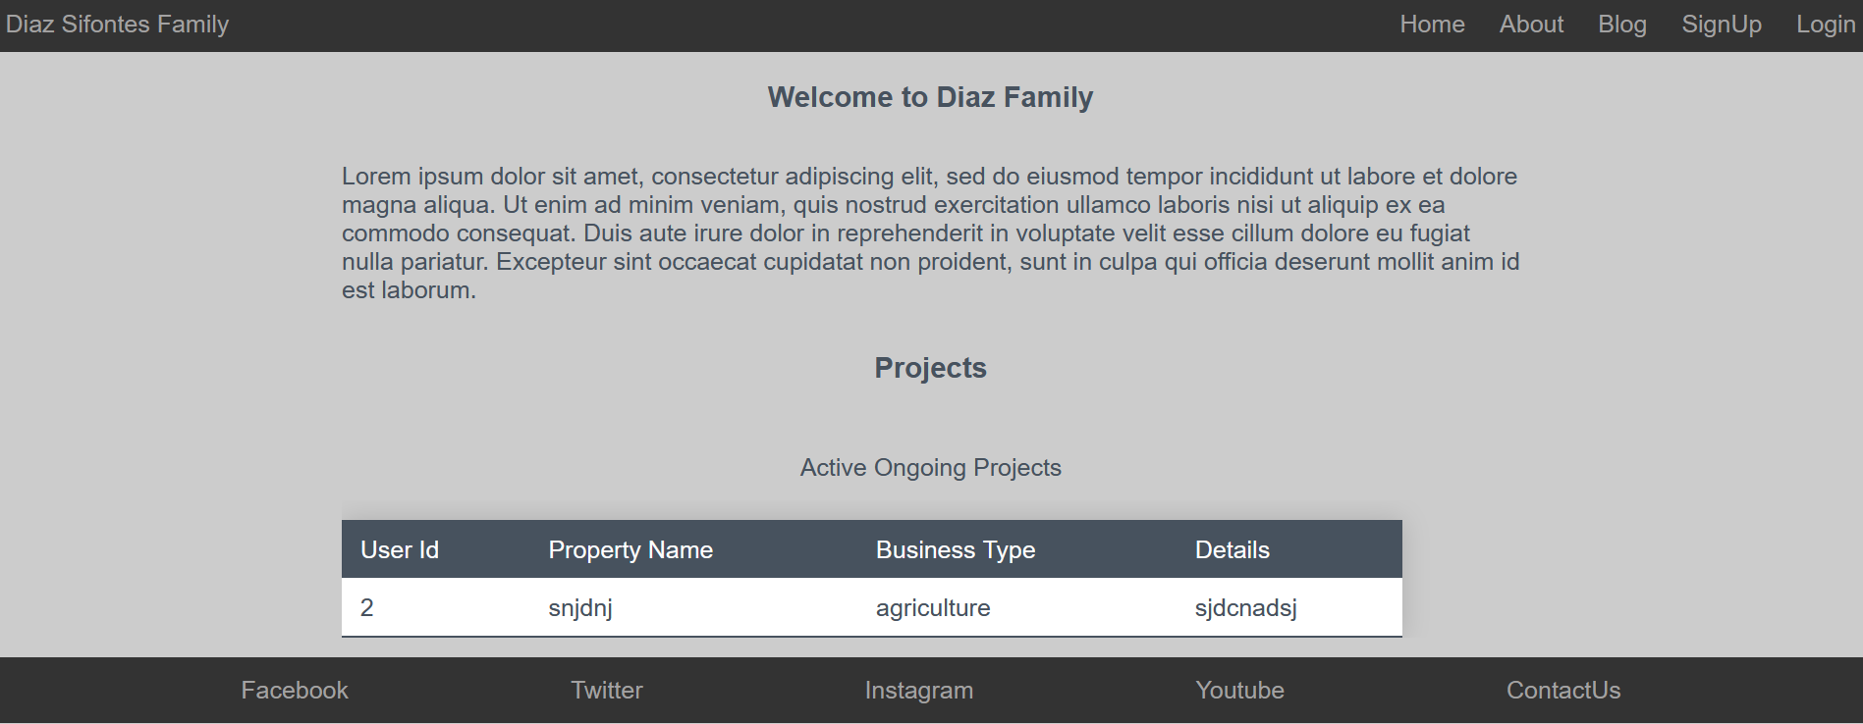
HOME

Slide 10
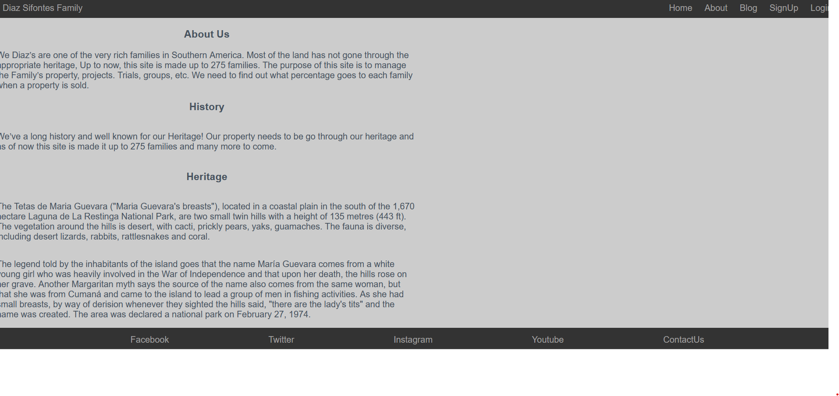
ABOUT

Slide 11
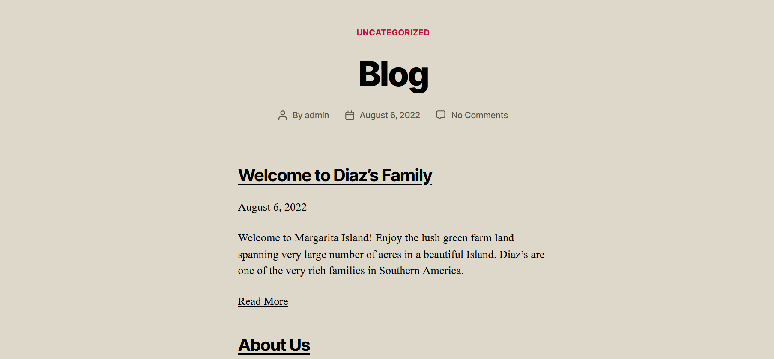
BLOG

Slide 12
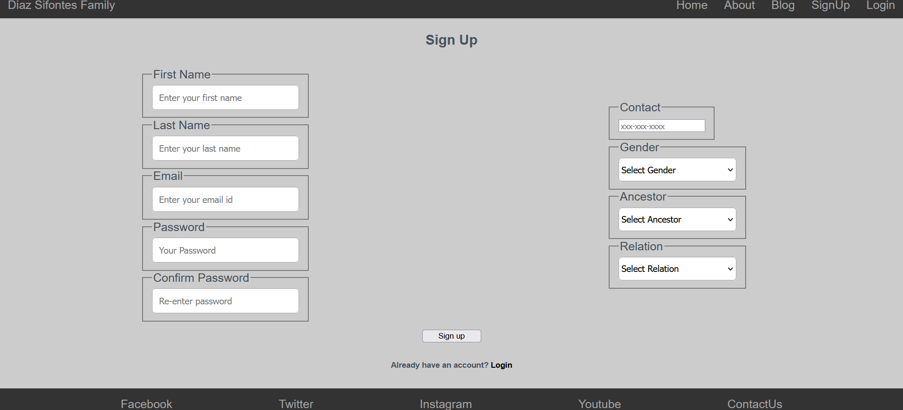
SIGNUP

Slide 13
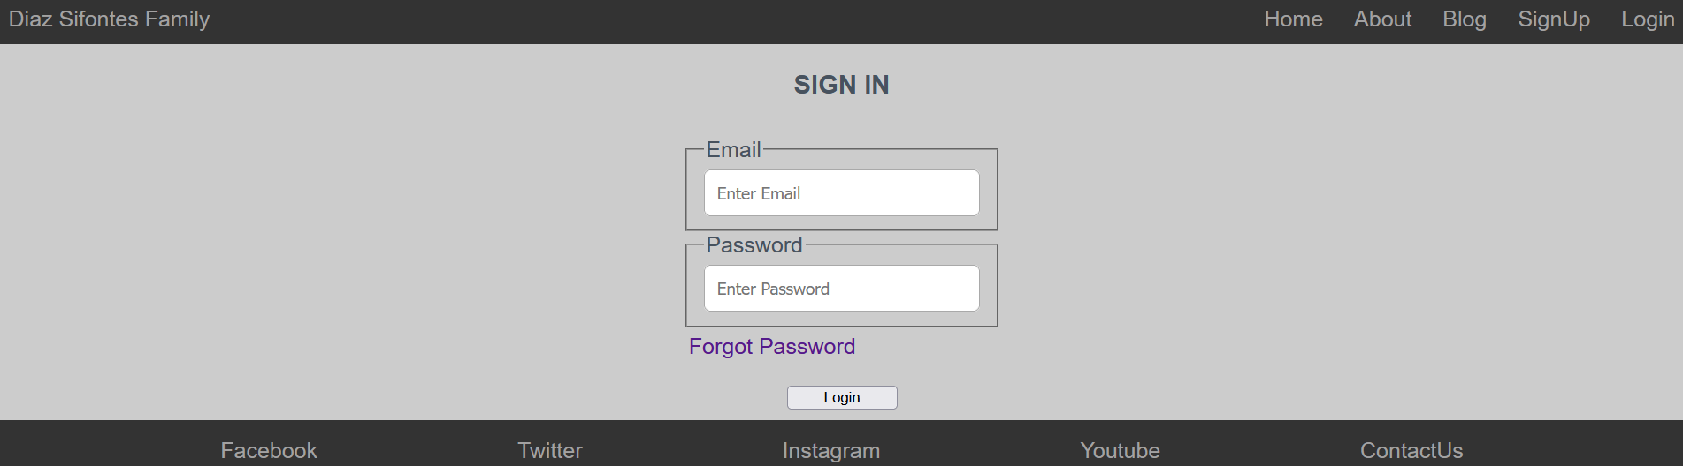
SIGNIN

Slide 14
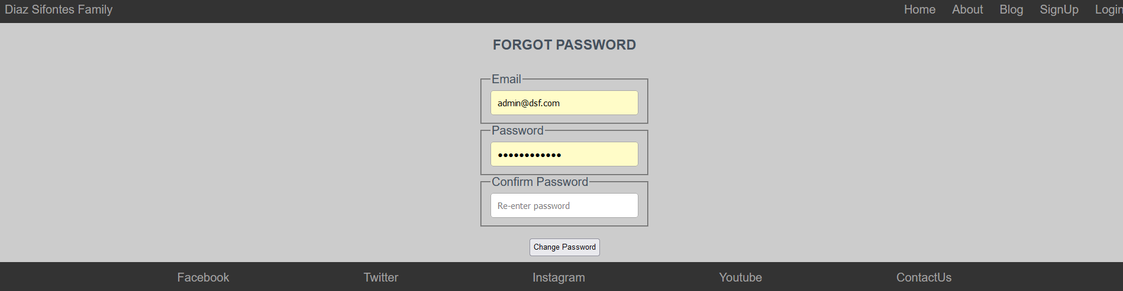
FORGOT PASSWORD

Slide 15
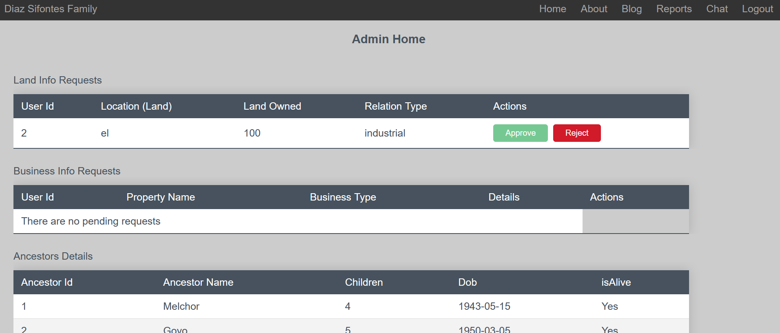
ADMIN HOME

Slide 16
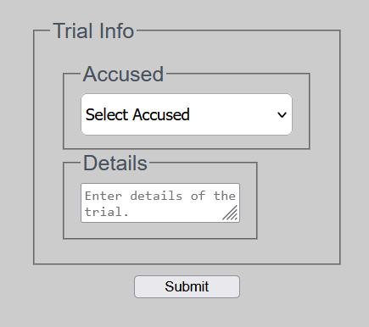
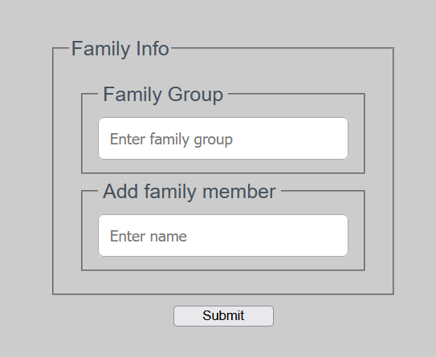
MEMBER HOME

Slide 17
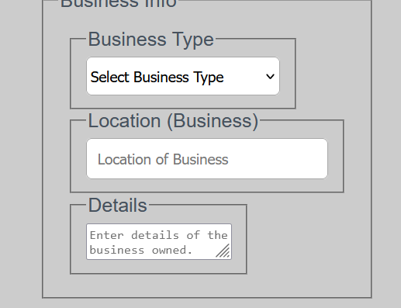
MEMBER HOME

Slide 18
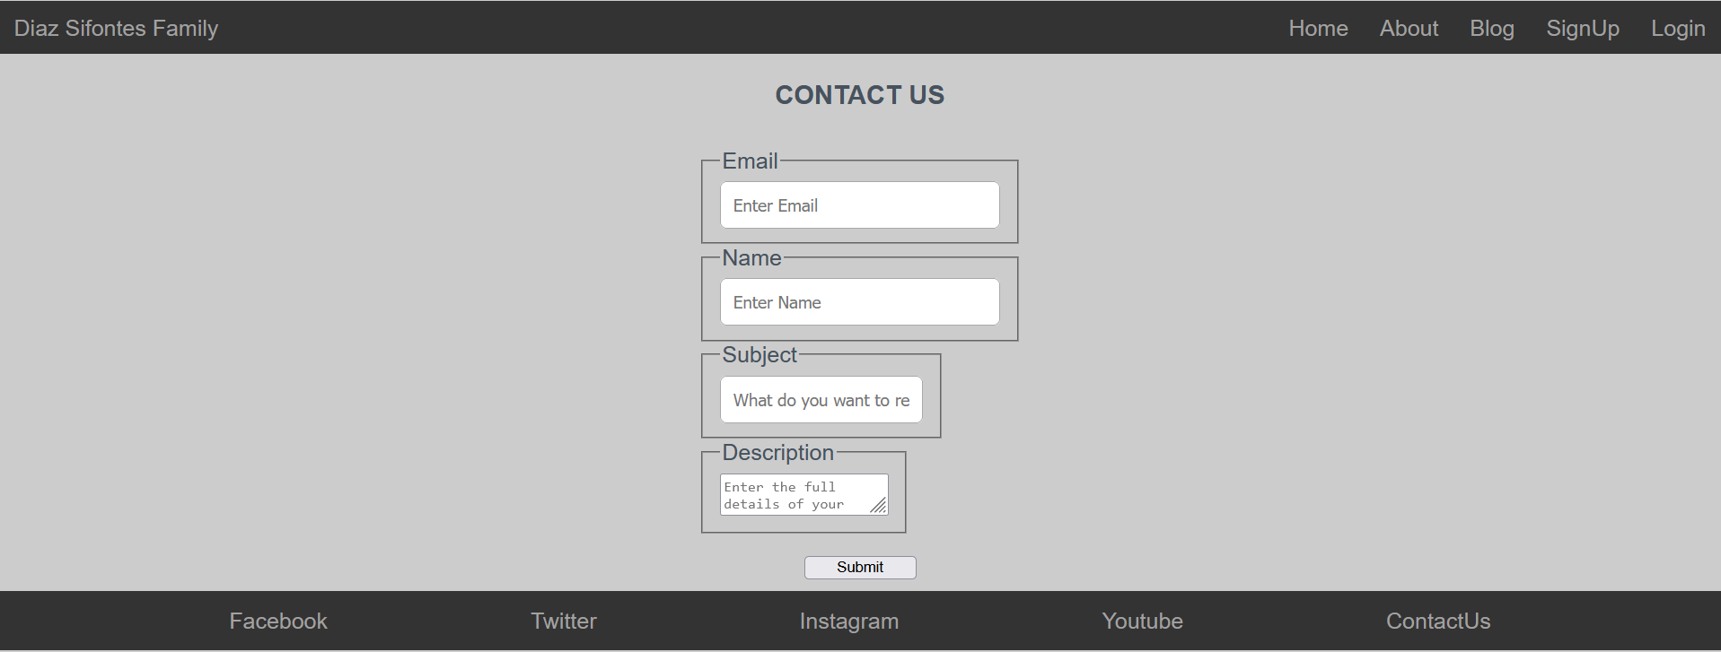
CONTACT US

Slide 19
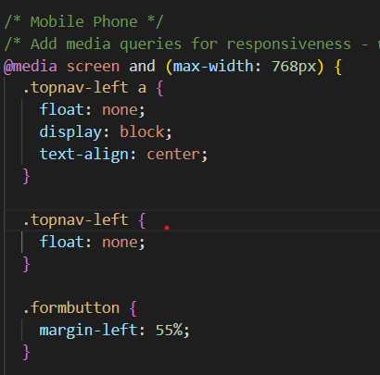
CLASS RELEVANCE
Media screen has been used to include page responsiveness of the website

Slide 20
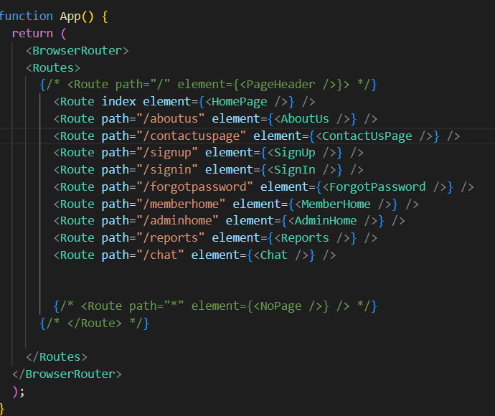
Contd.
Usage of Reacts Browser Router and Route to navigate through pages

Slide 21
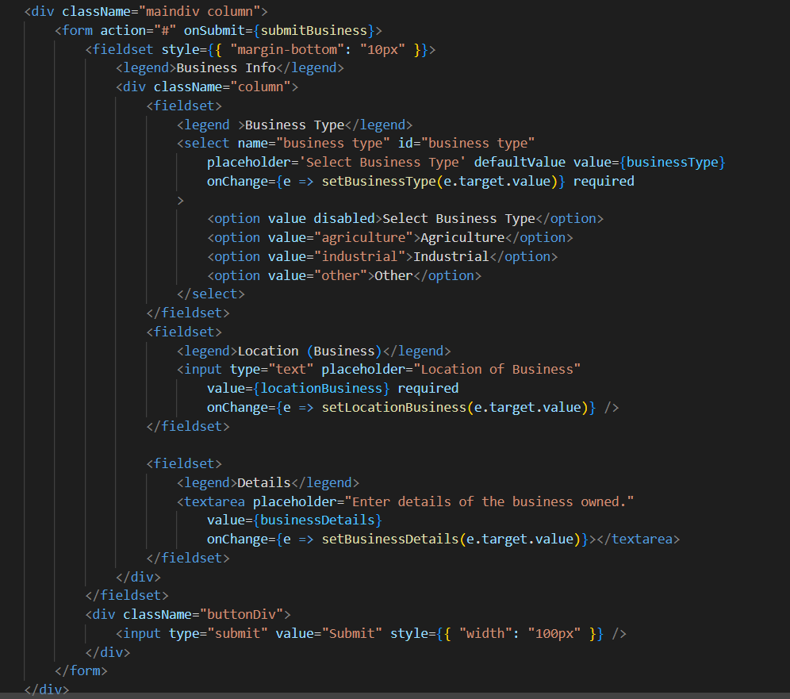
Contd.
Usage of forms and functions related to forms like onSubmit, onChange and onClick.

Slide 22
Challenges Faced
Being from different educational backgrounds, we had to learn a lot in such a short period of time.
Especially, communication was a bit off during the start of the project and then it streamlined.
Concepts like Laravel and Node.js were relatively new and was really hard to complete them in a day.
Initially, we did find a challenge to host the website on to the cloud, but at the end we were able to do it

Slide 23
Future Modifications
Going forward, we would like to completely re-design the front-end using bootstrap as it gives an even more dashing look
We started doing the chat module in Node.js but couldn’t complete it. Given some more time we can implement that functionality completely.
We would also like to learn and implement SMTP Mail Server.
Furthermore, we would like to make the website more dynamic by including data as a drop down from the backend for as many fields as possible.

Slide 24
PLANS
Each of us have a different plan for this website.
However, in common, we would like to include this website on our portfolios and resumes keeping in mind the upcoming interviews.

Slide 25
THANK YOU
Note:
Any one of us can be reached out through teams or outlook
rxu4009@mavs.uta,edu
bat5491@mavs.uta.edu
sxr9731@mavs.uta.edu

